Slide 1
Student INDUSTRIAL Training scheme CARRIED OUT AT FOL-HOPE NIGERiA LIMITED by name: OJO TOlUWANIMI MATric no: 2015/1396 college of environmental resources management. Department of aquaculture and fisheries management federal university of agriculture, abeokuta

Slide 2
Brief history about fol-hope Nigeria limited.
Fol-hope Nigeria limited has her headquarters situated at k/lm 3.old ife
road near new airport, alakia Ibadan oyo state. It started in 1972 with
about 3000 fingerlings inside a concrete tank ,presently the farm had
increased tremendously.
It has many sections poultry, feedmill ,piggery ,hatchery etc. it has
about eighteen branches all over south west Nigeria
.

Slide 3
SECTIONS AVAILABLE AT FOL-HOPE NIGERIA LIMITED
FISHERY SECTION
FISH FEEDMILL SECTION
POULTRY HATCHERY SECTION
POULTRY FEEDMILL SECTION
PIGGERY SECTION
POULTRY SECTION
VETERINARY SECTION

Slide 4
FISHERY SECTION

Slide 5
In fisheries section,we have the following
Earthen pond
Concrete tank
Fibre glass tank
Pelletizing machine
Hatchery

Slide 6
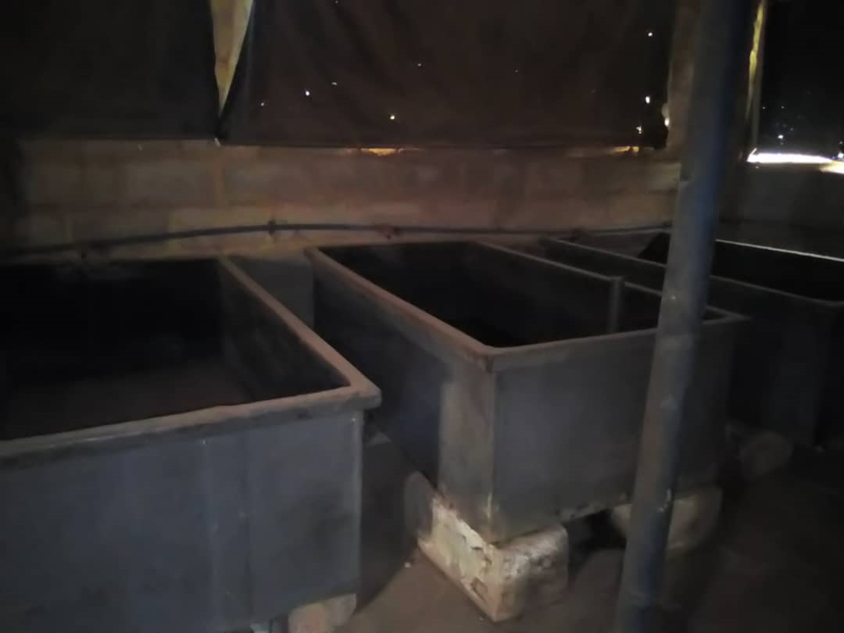
FIBRE GLASS TANKS

Slide 7
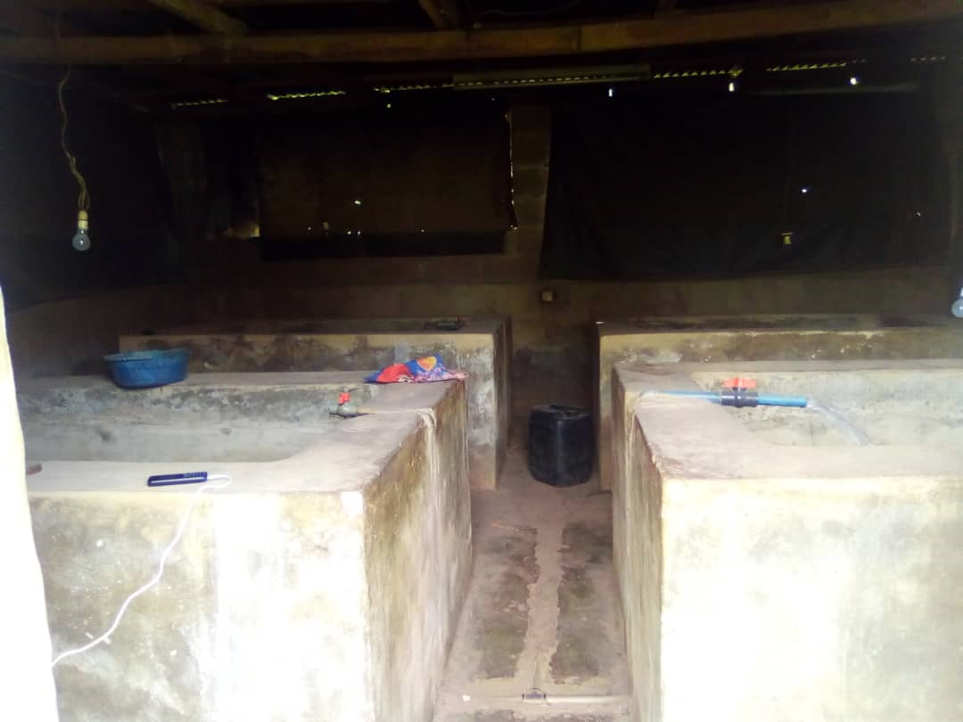
HATCHERY ROOM WHERE FRY ARE RAISED

Slide 8
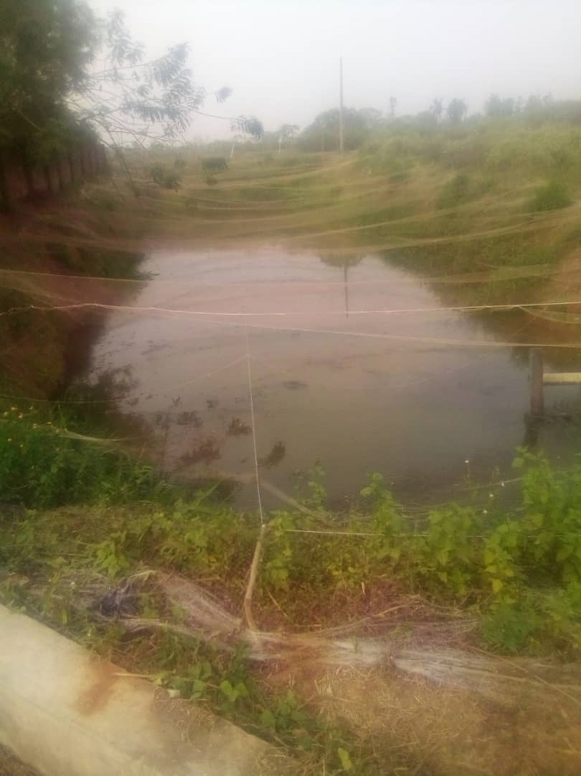
EARTHEN POND

Slide 9
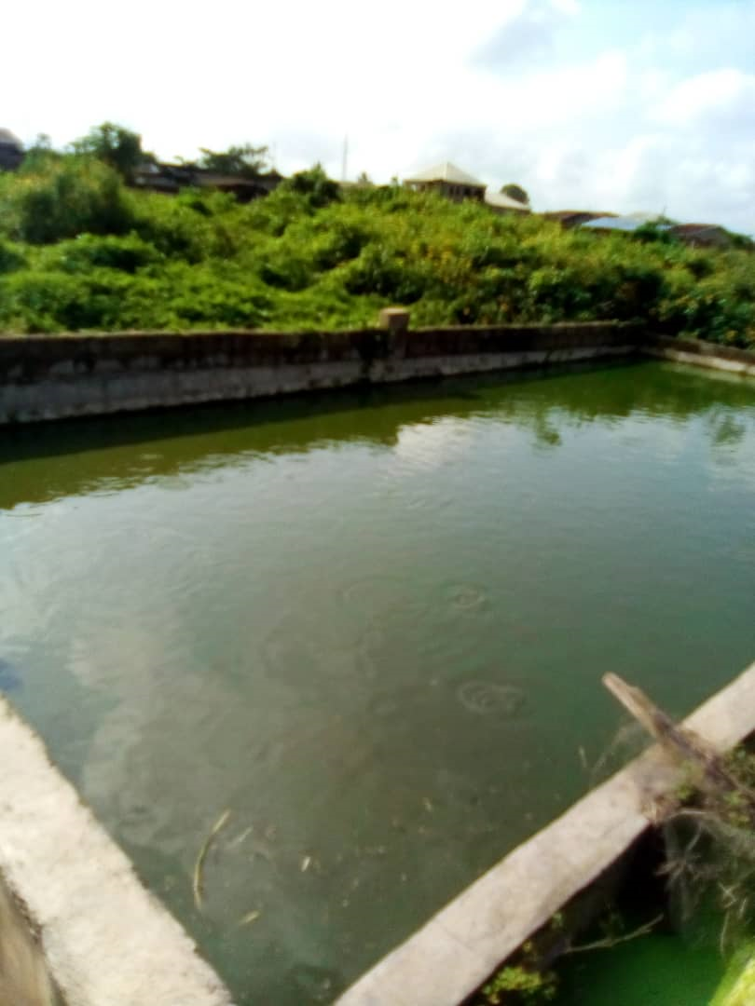
CONCRETE TANK

Slide 10
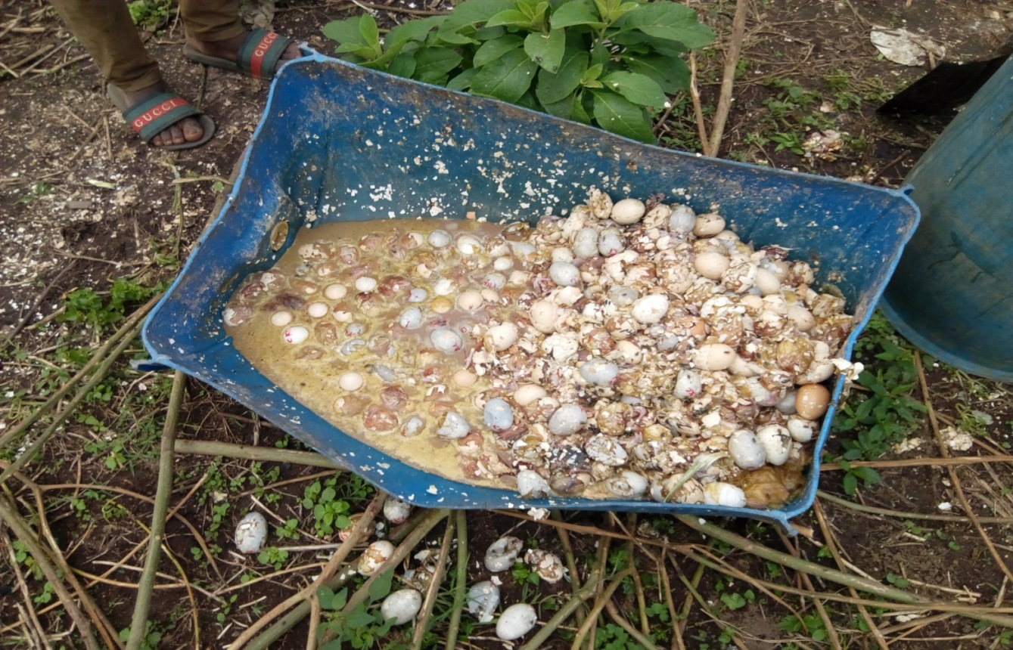
UNSUCCESFUL HATCHLINGS FROM POULTRY (BANGer):THIS IS GOTTEN FROM THE POULTRY AND GIVEN TO THE FISHES WHEN COOKED.

Slide 11
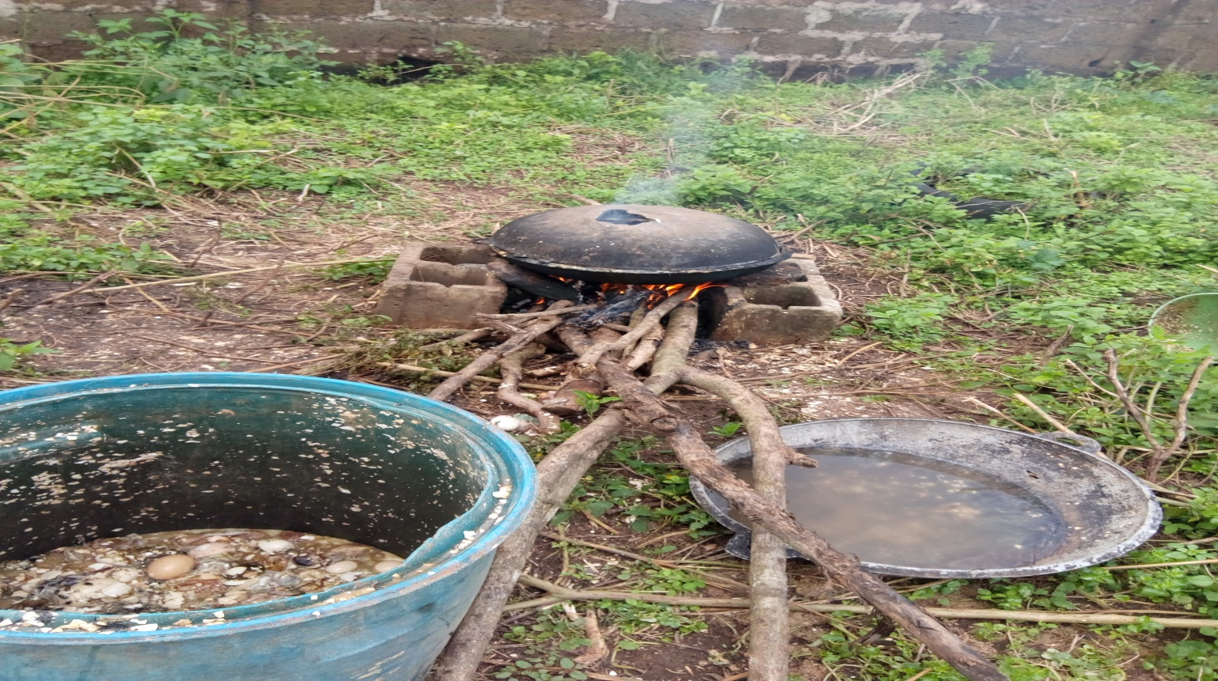
Cooking of unsuccesful hatchlings gotten from poultry hatchery: THIS IS DONE FOR 45MINUTES UNTIL THE WATER DRIES UP.

Slide 12
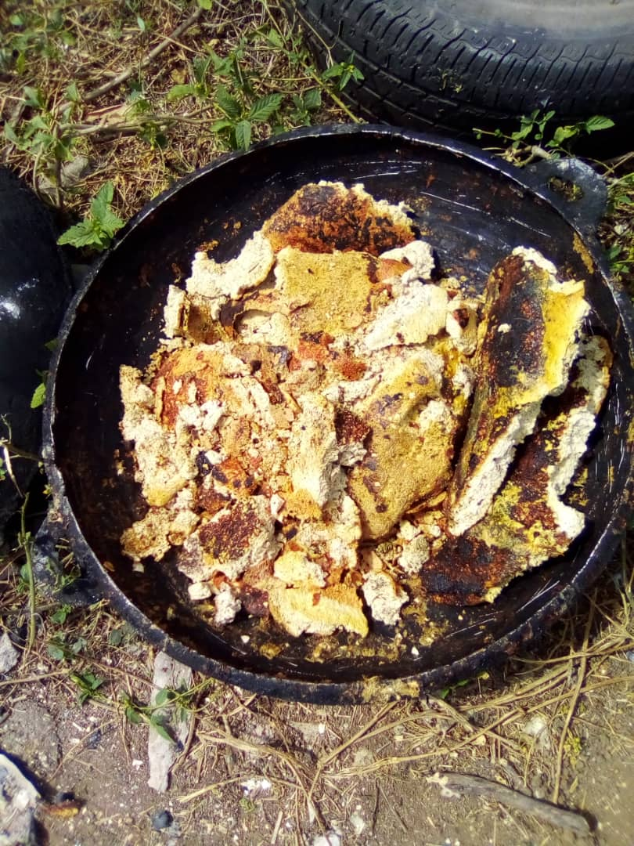
END PRODUCT OF THE UNFERTILIZED EGGS

Slide 13
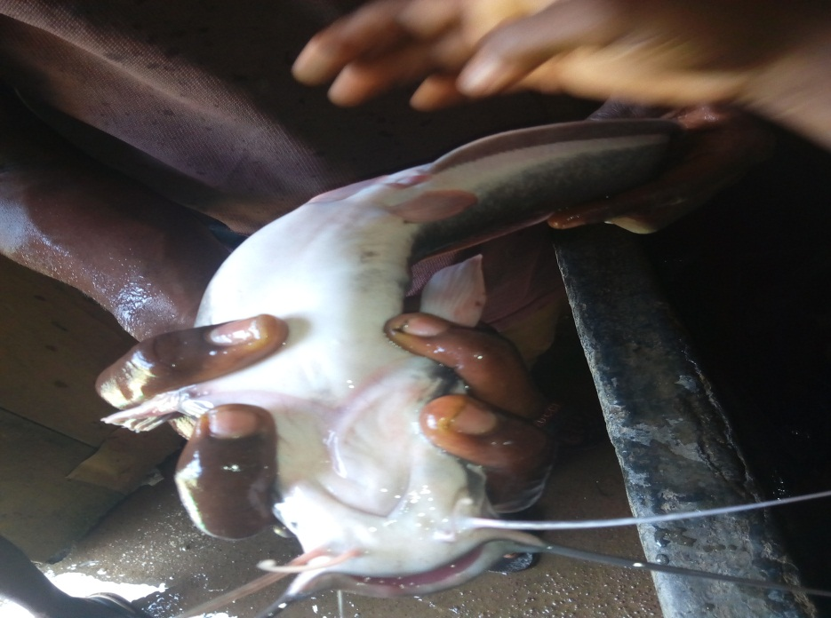
IDENTIFICATION OF SEXES(MALE AND FEMALE):FOR THE MALE PRESCENCE OF GENITALL PAPILLA HAS A REDDISH COLOURATION,THE ABDOMINAL REGION IS IN ALIGNMENT WITH THE BODY. FEMALE: PRESCENCE OF GENITAL ORIFICE ,THE ABDOMINAL REGION IS BULGY,BIGGER,EXTENDED,BIGGER AND SOFT TO TOUCH.

Slide 14
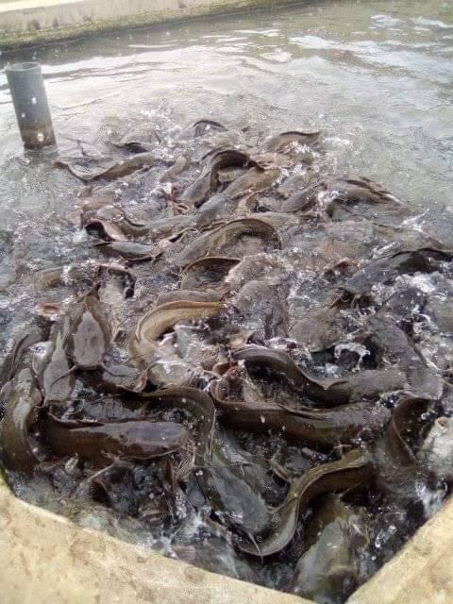
Harvesting of fishes in earthen pond

Slide 15
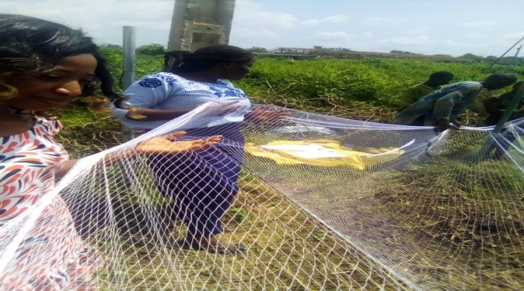
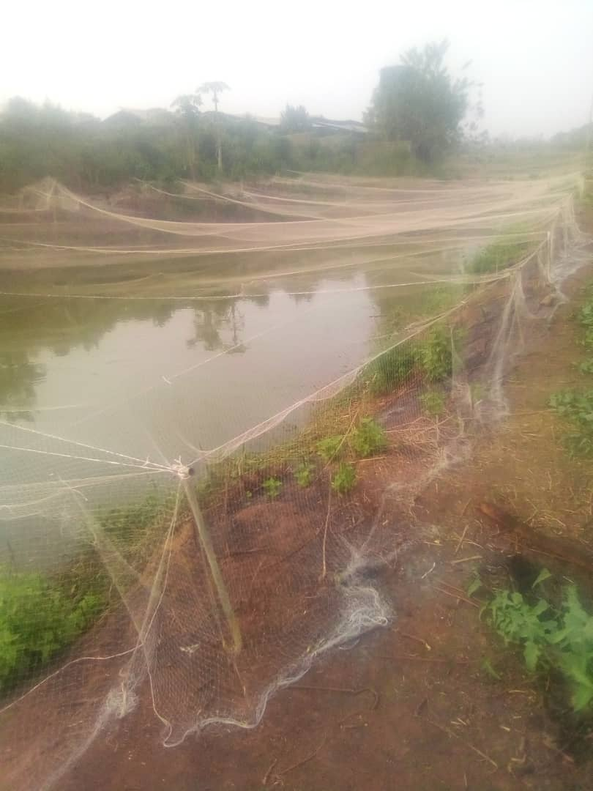
PEGGING AND NETTING: two weeks after liming the pond with phostoxin (having 57% aluminium phosphate) as chemical, we cut sticks into same sizes and we dug holes into the ground ,d sticks was inserted to various ends, we net the pond using twine to hold the peg together in rectaNGULAR FORM,IN ORDER TO ALLOW THE NET TO BE FIRM.

Slide 16
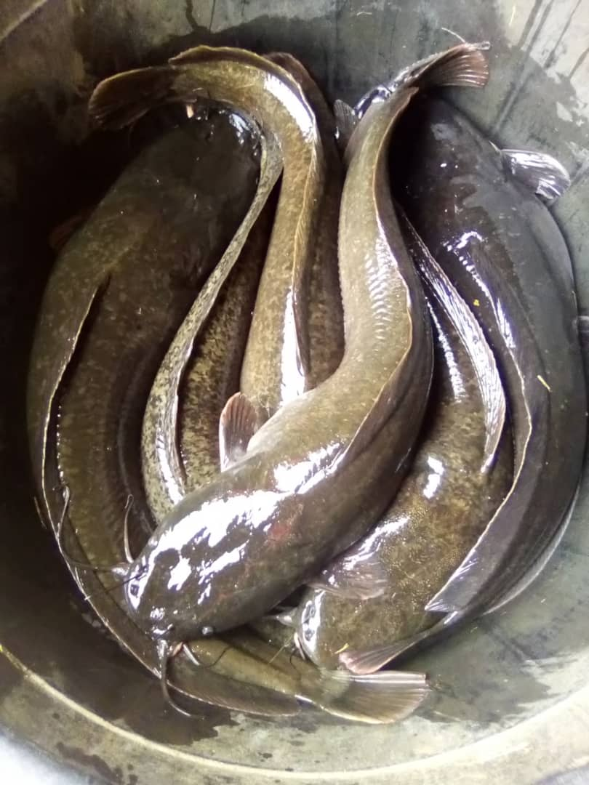
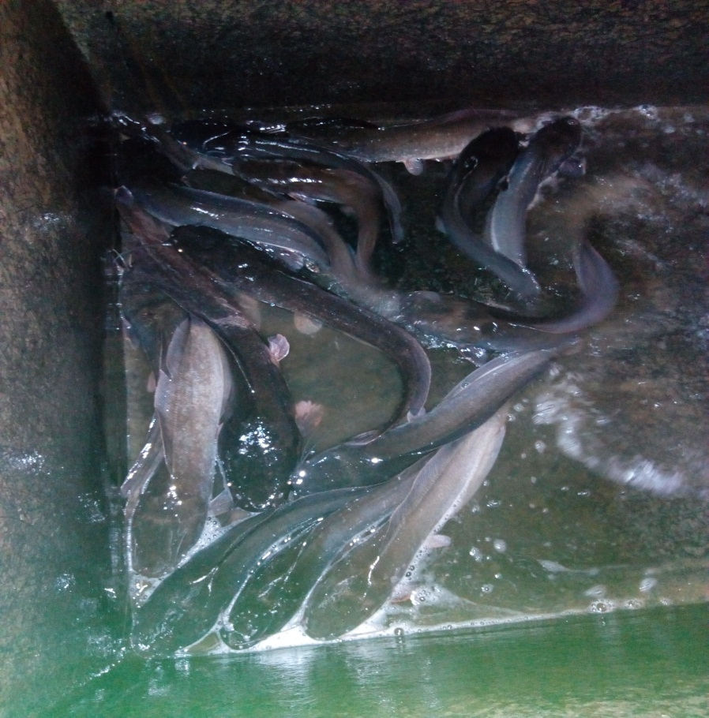
CAPTURED FISHES FROM CONCRETE TANK

Slide 17
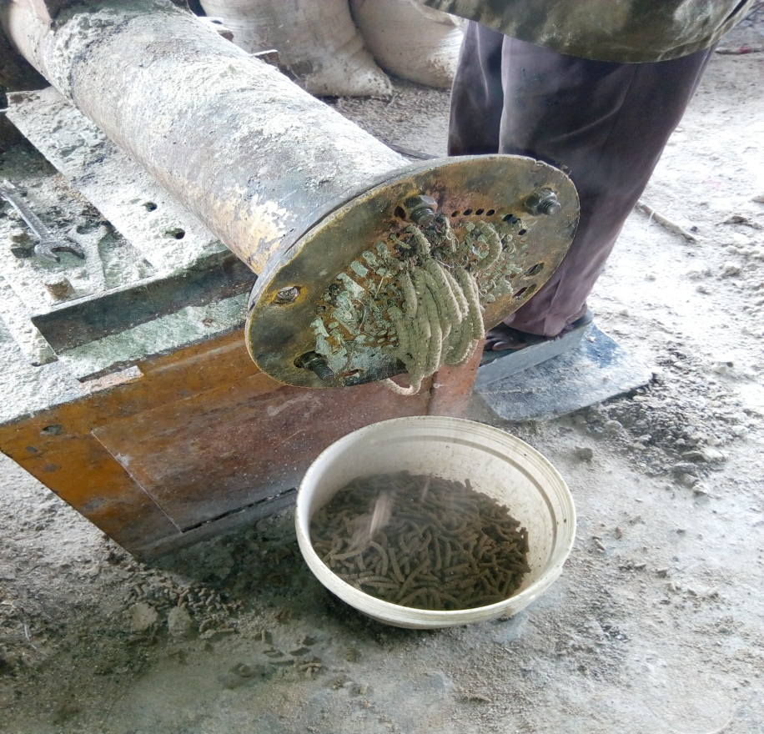
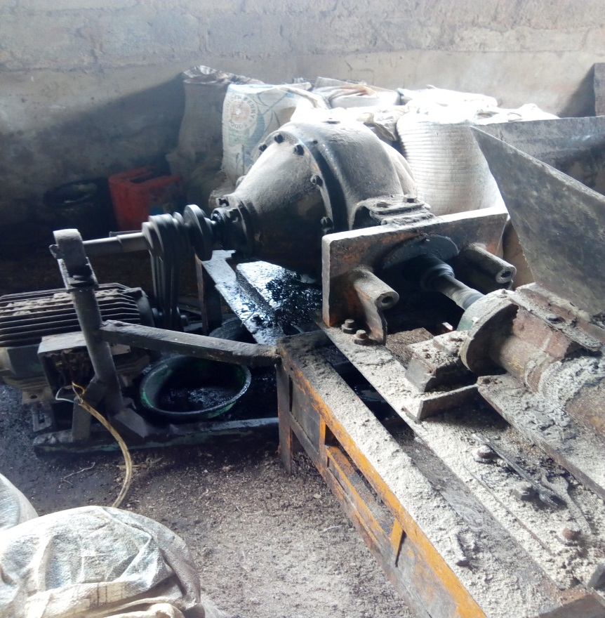
Making of LOCAL FEEDS USING PELLETIZING MACHINE: USED FOR CONVERTING FEED INGREDIENT THAT ARE IN MASH FORM INTO DRY PELLETS

Slide 18
FEEDMILL SECTION

Slide 19
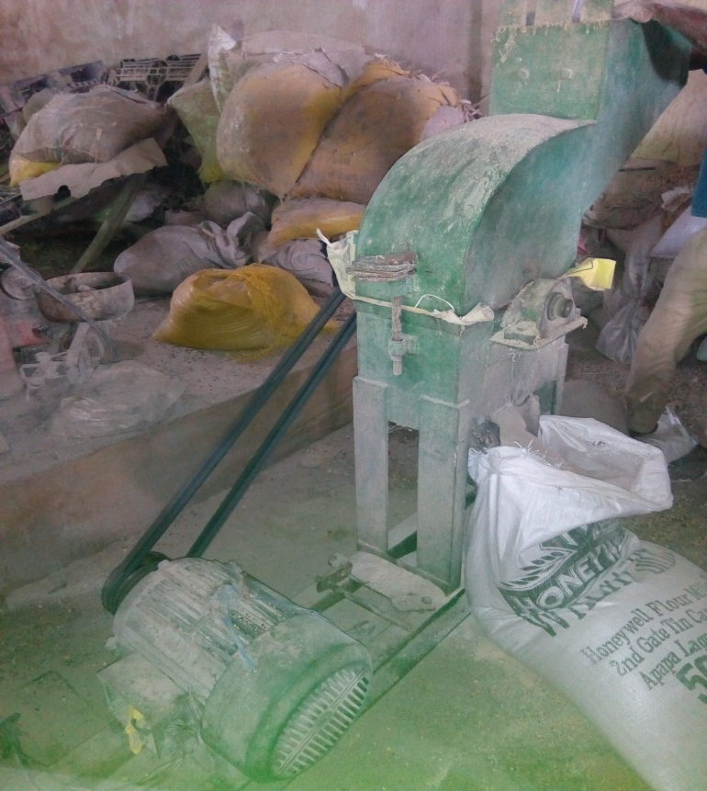
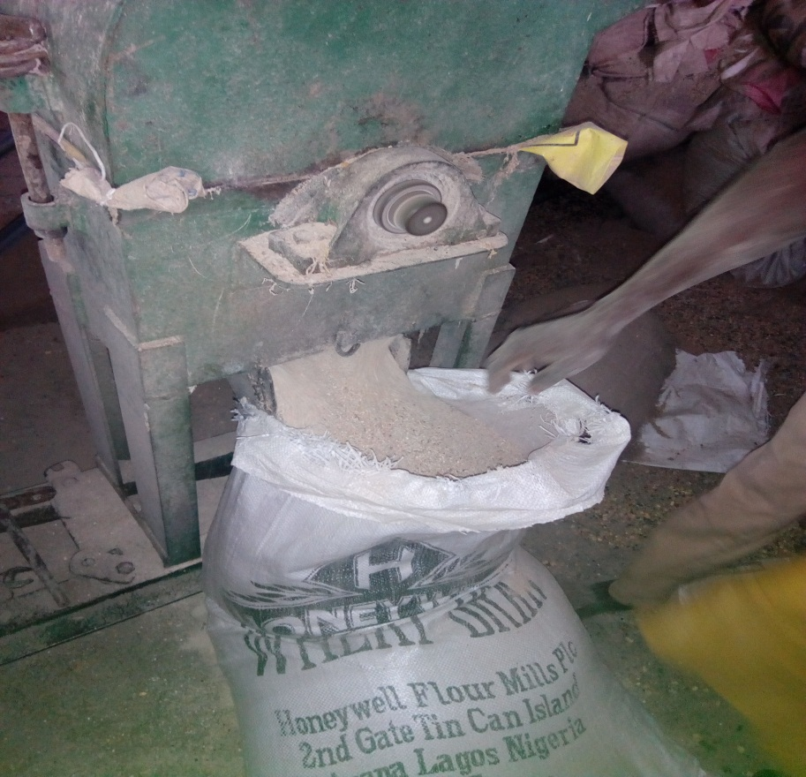
GrindING MACHINE: HERE LARGE CLUMPS AND FRAGMENTS ARE REDUCED IN SIZE TO POWDERED FORM.

Slide 20
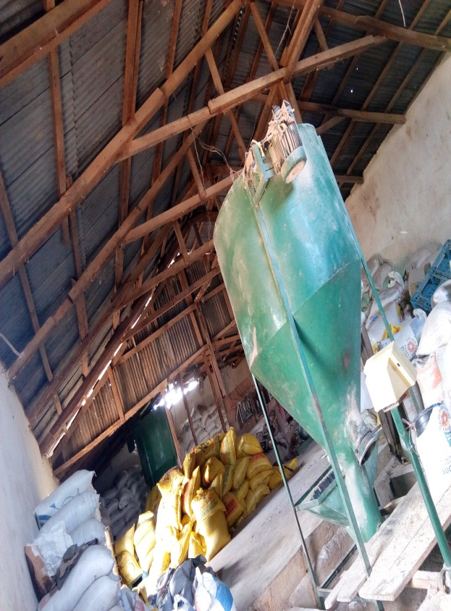
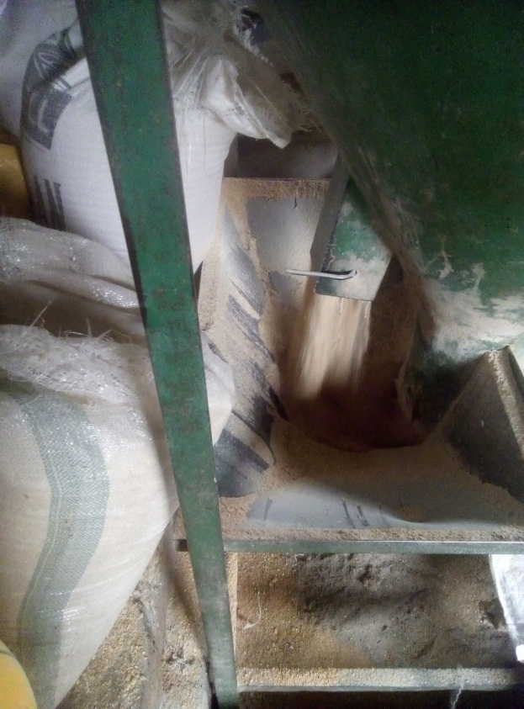
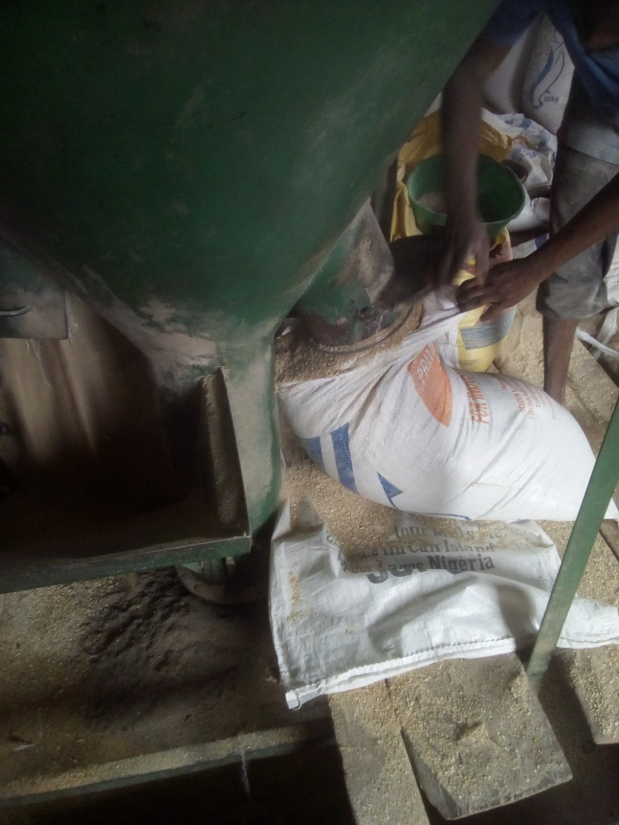
MIXING MACHINE:ARE USED IN FEEDMILL FOR THE MIXING OF FEED INGREDIENTS AND PREMIX.

Slide 21
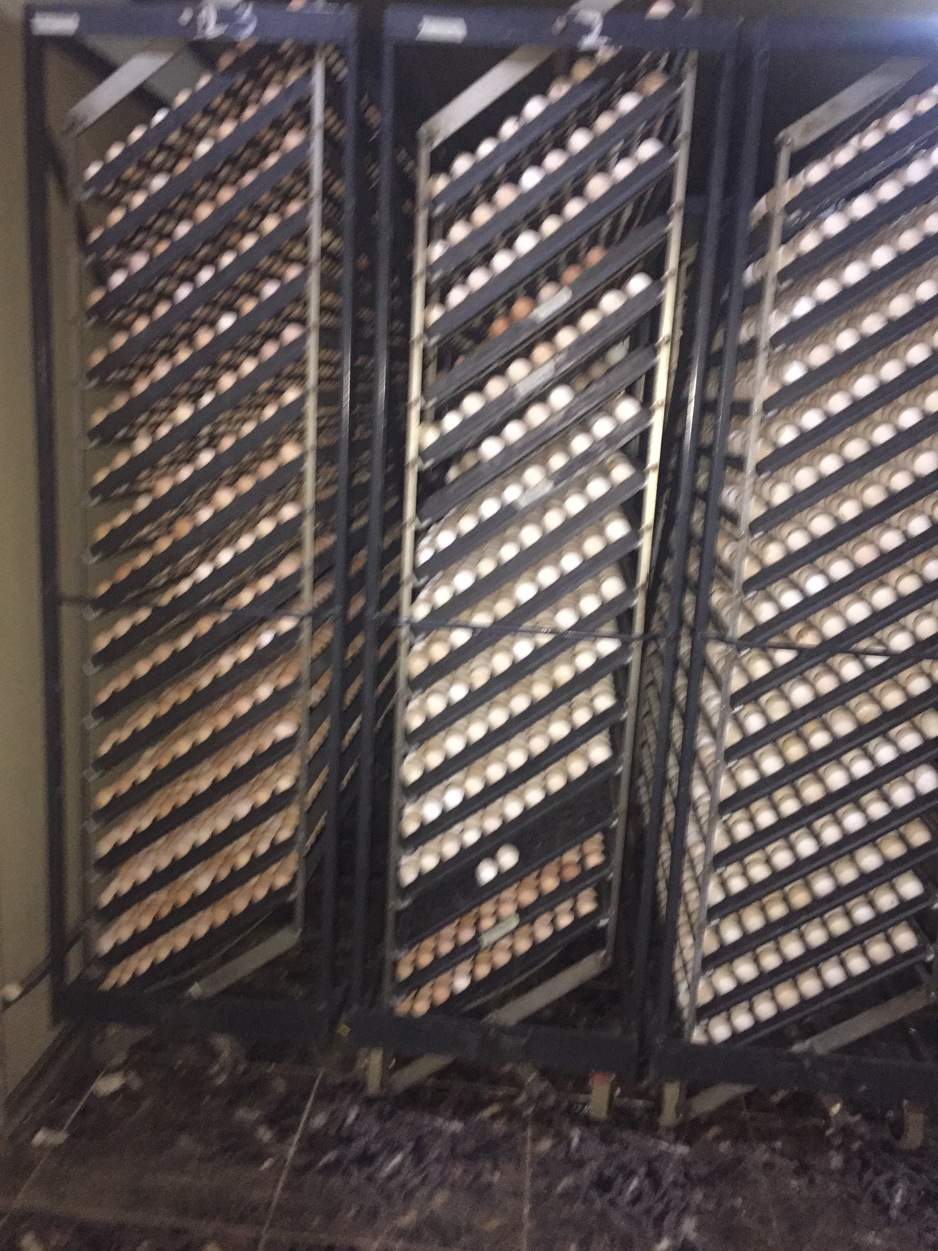
POULTRY HATCHERY
HATCHERY ROOM CONTAINING THE SETTER INCUBATOR AND THE HATCHER INCUBATOR

